Slide 1
Kacha Bazar . Com A ONLINE SHOPING SYSTEM

Slide 2



Presented by
Md Asaduzzaman Masum
ID :- CSE 06307433
Md Shamim
ID :- CSE 06307456
Toufiq Anam Fahim
ID :- CSE 06307436

Slide 3
Introduction
What is Online Shop?
Types of User

Slide 4
Project Motivation
Solving Real life time problem
Security assurance for the user
Safety of Payment for users
Administrative tasks easier for the staffs

Slide 5
Our Project Goals
Increase sales
Winning new contacts/leads
Winning new customers
Increase customer satisfaction and retention

Slide 6

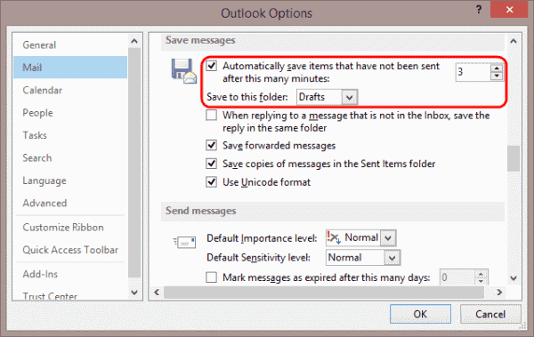

Features
Autosaving Drafts
Cloude Sharing
Native Email Communication

Slide 7

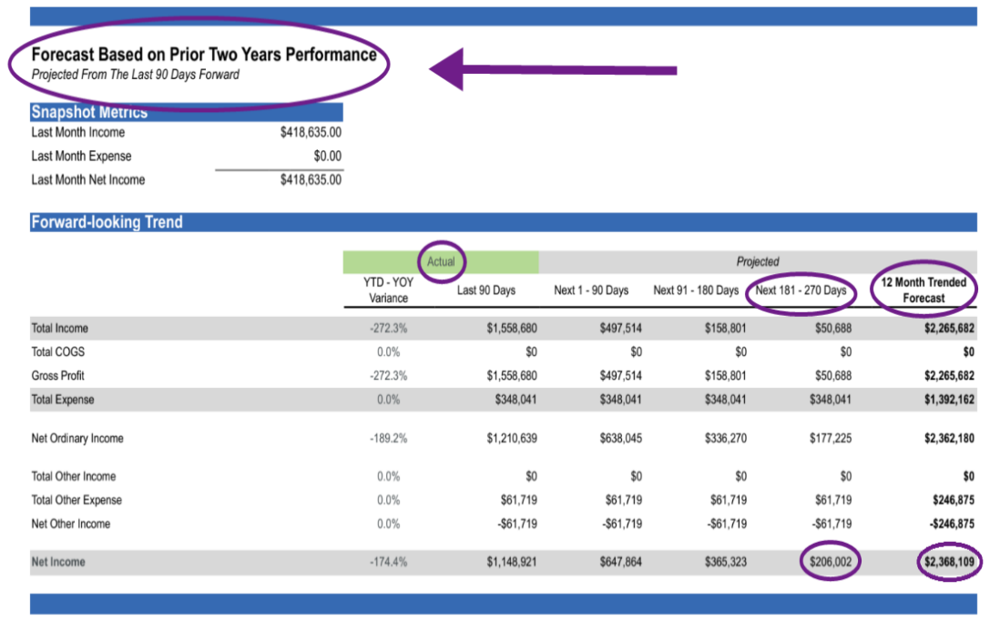
Features
secure Online Evaluation
Custom Reporting

Slide 8
Feasibilities
Technical Feasibility
Economic Feasibility
Operational Feasiblity

Slide 9

Cost Benefit Analysis
User Sided Cost & Benefit
Administrator Sided Cost & Benefit

Slide 10
Users Sided Benefits and Costs
Benefits
Costs
24/7 Services
Home Delivery
Save time & Transport Costs
Easily Choose the best one
Compare Two products
Service Charge
Hardware Costs.
Internet bill
Payment Costs
Vat Charge

Slide 11
Administrator sided Benefit & Costs
Benefit
Costs
Gain Access to Customer Data Easily
Get Payment by Customer
Real Life problem Solving
New Experience
Collection data and information
Hardware
Software development
Management Costs
Internet bill

Slide 12

Project Scheduling
In Project Scheduling I asks myself three questions to start -
1. What needs to be done? 2. When will it be done? 3. Who will do it?

Slide 13
Planning
Activities | Description | Week | Precedence
Part 1 | Communicatin | 3 | 2,3
Part 2 | Planning | 6 | none
Part 3 | Modeling | 3 | none
Part 4 | Construction | 3 | 1
Part 5 | Deployment and Testing | 3 | 4

Slide 14
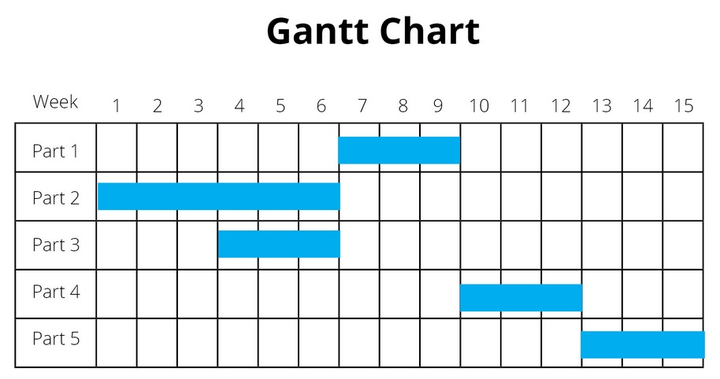

Slide 15
Risk Analysis
Backup Database
Secured Payment Method
Backup Hardware
To use secure passwords
Keep an eye on pricing

Slide 16

Have you any Question?

